Slide 1


Affective Neuroscience | fall 2024
Lecture 01
Lecture 01
Introduction to Affective Neuroscience
CHOONG-WAN WOO | COCOAN lab | http://cocoanlab.github.io

Slide 2
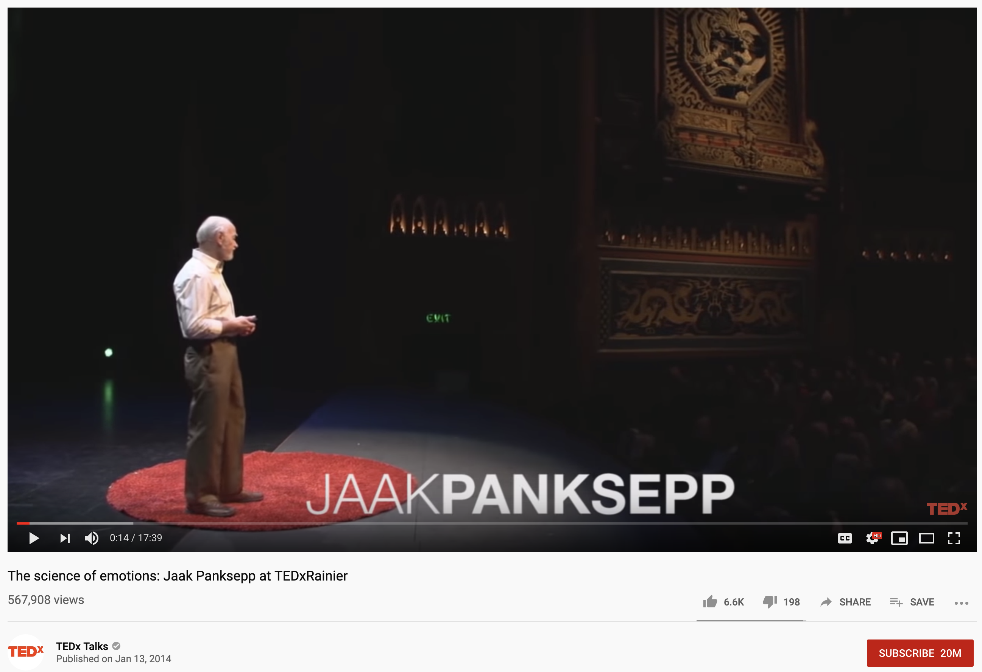
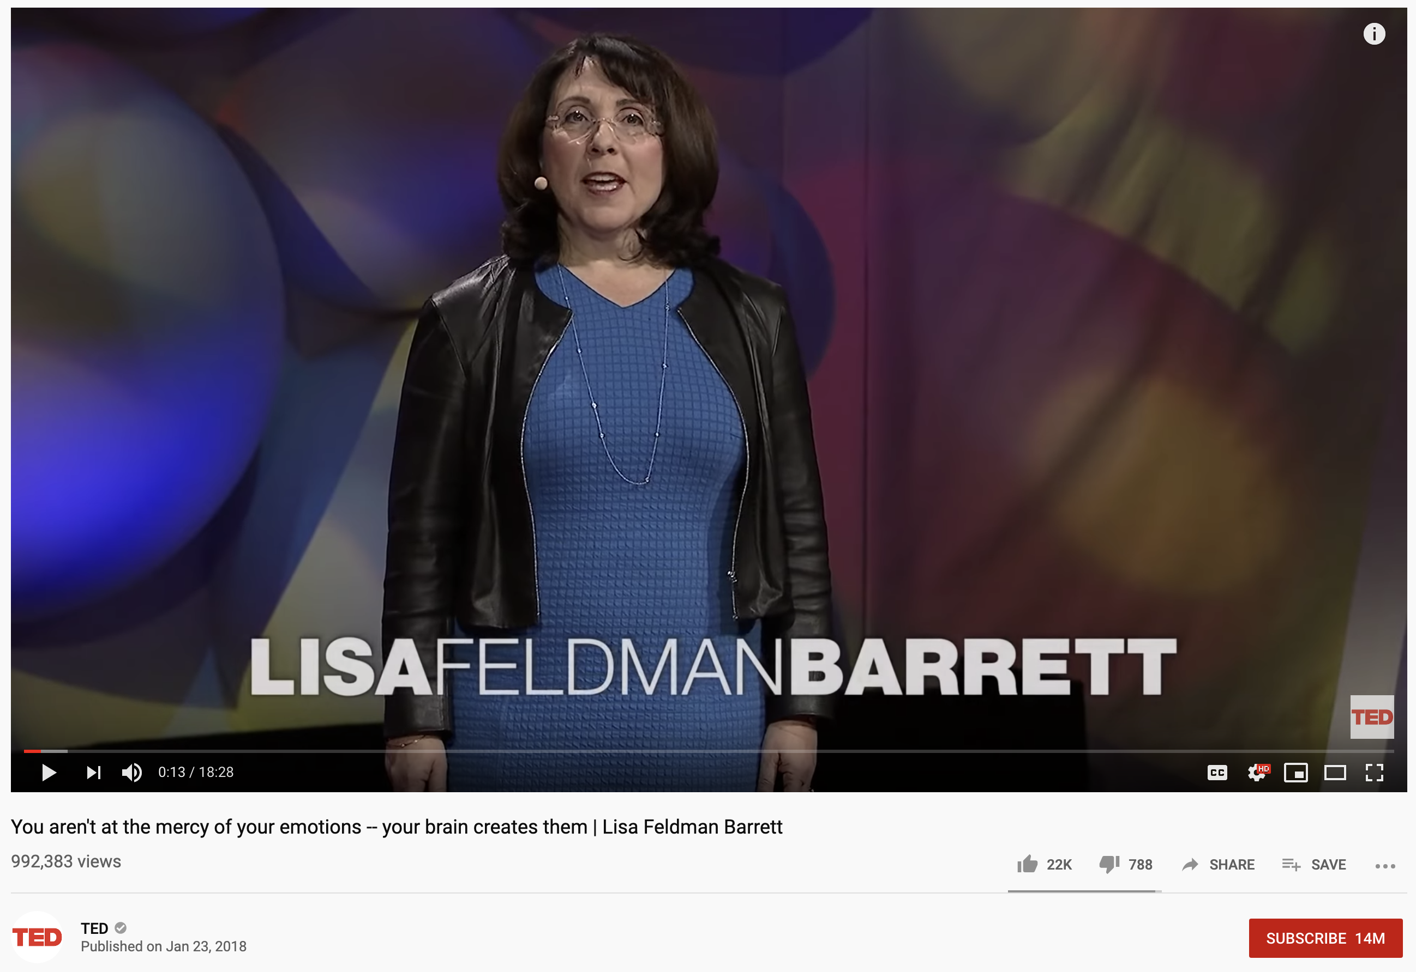
Let’s watch these together
https://www.youtube.com/watch?v=65e2qScV_K8
https://www.youtube.com/watch?v=0gks6ceq4eQ
CHOONG-WAN WOO | COCOAN lab | http://cocoanlab.github.io

Slide 3
Differences between these two talks?
https://www.youtube.com/watch?v=65e2qScV_K8
https://www.youtube.com/watch?v=0gks6ceq4eQ
CHOONG-WAN WOO | COCOAN lab | http://cocoanlab.github.io

Slide 4
What do you think how we can define emotion?
Bodily (physiological) response
Prediction
CHOONG-WAN WOO | COCOAN lab | http://cocoanlab.github.io

Slide 5
Does emotion happen? or do we make emotion?
Emotion happens
We make emotions
CHOONG-WAN WOO | COCOAN lab | http://cocoanlab.github.io

Slide 6
Can you read emotions from other’s face?
Yes
No
CHOONG-WAN WOO | COCOAN lab | http://cocoanlab.github.io

Slide 7
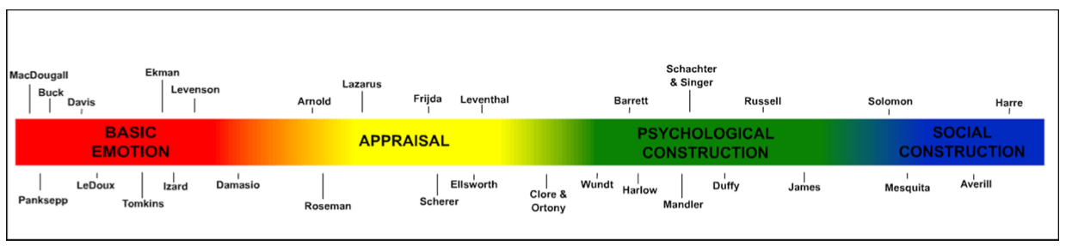
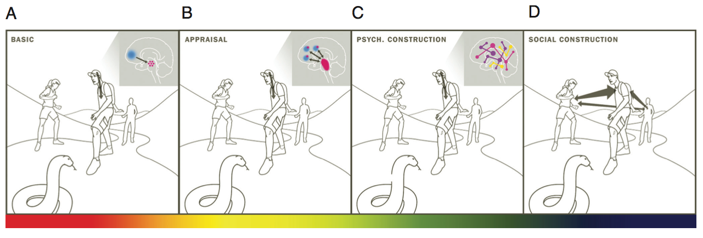
Emotion theories
CHOONG-WAN WOO | COCOAN lab | http://cocoanlab.github.io
Gross & Barrett, 2011

Slide 8
Slide credit: Tor Wager
What is affective neuroscience?
Affect:
Brain/mind processes related to value, survival, and well-being… so fundamental
A basic sense of feeling, ranging from unpleasant to pleasant (valence), and from agitated to calm (arousal)
A feature of consciousness
Building blocks of emotion
Conscious or unconscious
Closely related to interoception:
the sense of the internal state of the body
CHOONG-WAN WOO | COCOAN lab | http://cocoanlab.github.io

Slide 9
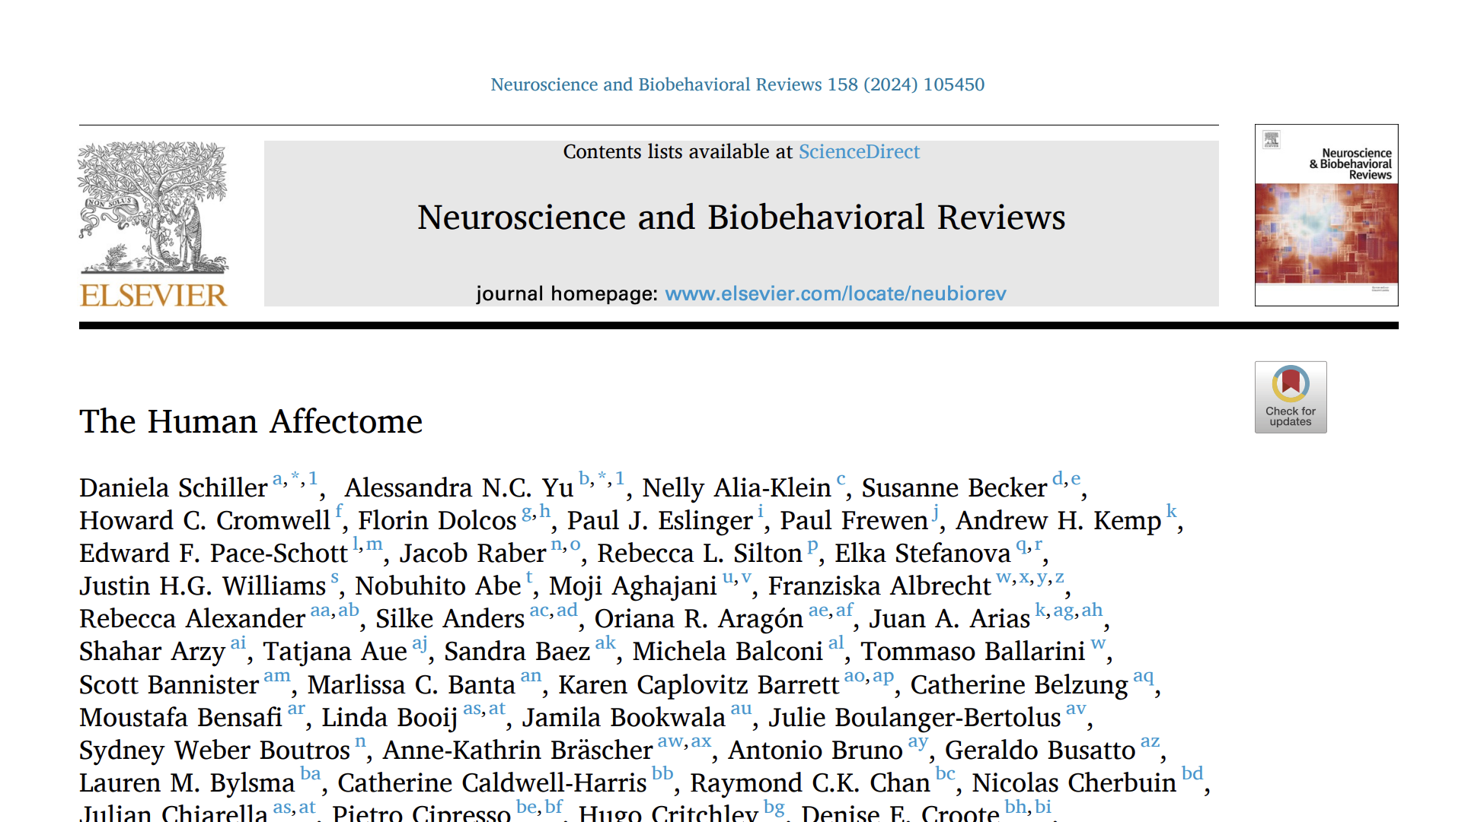
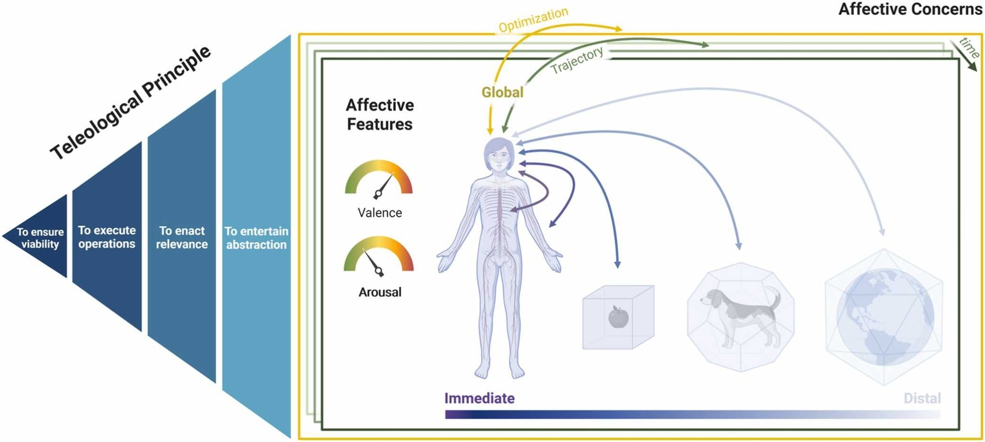
The Human Affectome
Experienced, Situated
(feeling, phenomenal)
Allostasis and control
(action, operational)
Homeostasis
(physiological needs)
Language, social,
distal, etc.
CHOONG-WAN WOO | COCOAN lab | http://cocoanlab.github.io

Slide 10
Slide credit: Tor Wager
What is affective neuroscience?
Affective neuroscience?
Study of human brain systems related to:
Emotion
Value and decision-making
Visceral sensations
Social cognition
Brain-body communication
Brain health disorders (Parkinson’s, pain, PTSD)
Physical health and well-being
Human
Neuroscience
Systems
Neuroscience
Affective
Neuroscience
Computational Sciences
Cognitive and Social Psychology
CHOONG-WAN WOO | COCOAN lab | http://cocoanlab.github.io

Slide 11

Slide credit: Tor Wager
Related emerging fields
Behavioral
Motivation sciences
Social neuroscience
Decision science
Neuroeconomics
Medical
Psychosomatic medicine
Psychoneuroimmunology/-endocrinology
Integrative medicine (mind-body medicine)
Technical
Informatics
Machine learning
Medicine
Artificial intelligence
Affective computing
Psychiatry
Clinical psychology
Social
Affective
Neuroscience
Law and policy
Arts, Pop culture
YouTube
Psychology
CHOONG-WAN WOO | COCOAN lab | http://cocoanlab.github.io

Slide 12
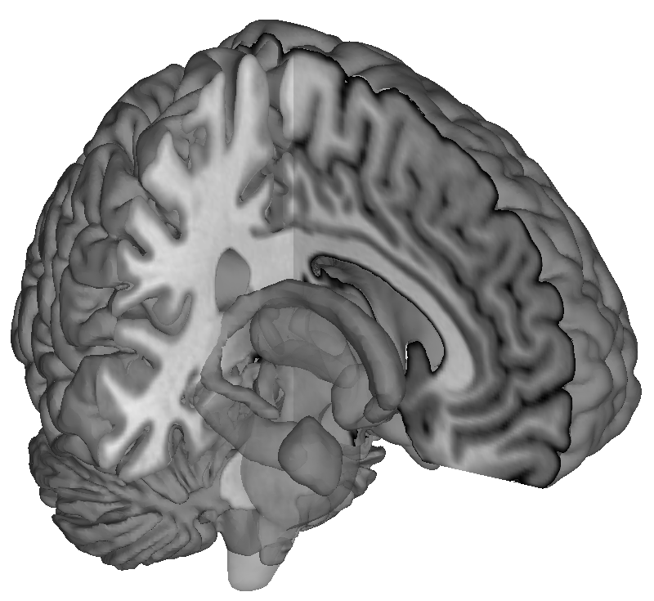
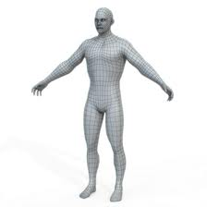

Slide credit: Tor Wager
Example research questions of affective neuroscience
What is the role of the brain in health?
Can we establish a physical basis for mental health disorders?
Can we develop better measures of emotion and emotional health?
Can we discover the physical mechanisms underlying feelings?
Can we understand willpower and self-control from a neurophysiological perspective?
Can this help us develop better interventions?
Can we measure feelings from patterns of brain activity?
Could this change legal practice and argumentation?
Brain
Interoception
Behavior
Sensation
Visceral
regulation
Body
Environmental
exposure
Social environment
Physical environment
CHOONG-WAN WOO | COCOAN lab | http://cocoanlab.github.io

Slide 13
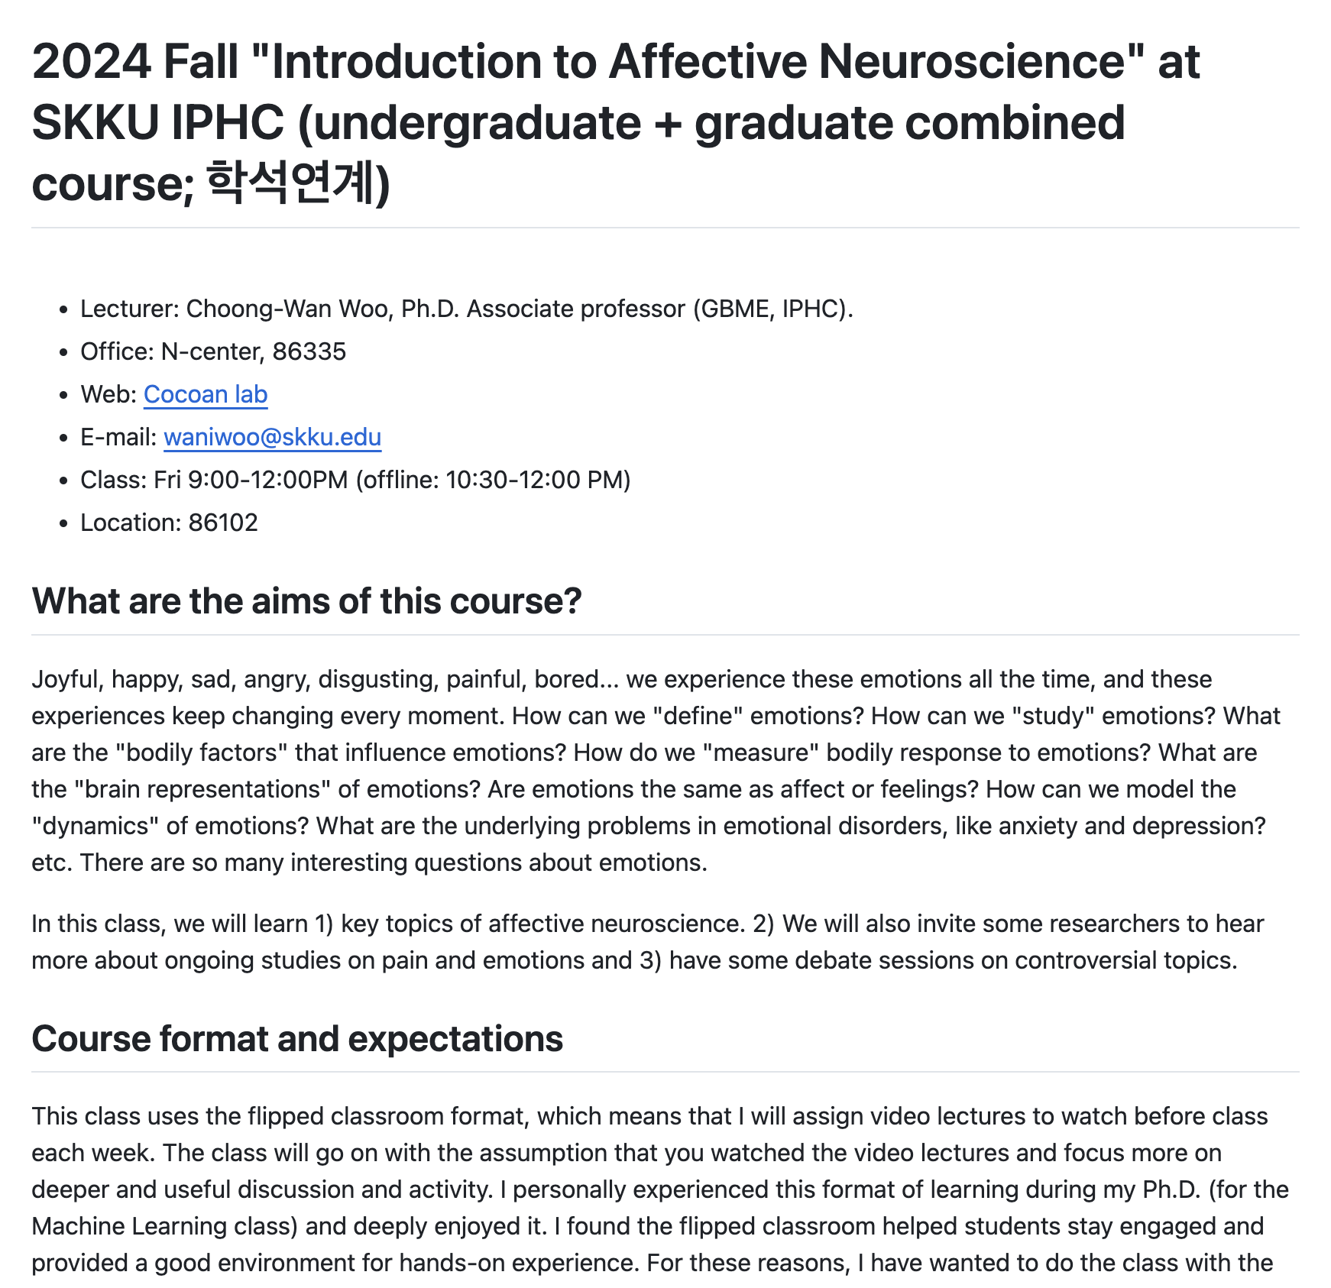
Syllabus: https://github.com/wanirepo/affectneuro_2024fall
CHOONG-WAN WOO | COCOAN lab | http://cocoanlab.github.io

